Slide 1
Latent variable models
6: More complex CFAs

Slide 2
Validity
Internal structure
Associations with other variables
Construct
Validity
Response Processes
Consequences of Use
Test Content

Slide 3

Friendship questionnaire design

Slide 4
Example data exercise
Load data in R:
item_dat <- readRDS(file = "Item data.Rda")
Define the model in lavaan, fit it to the dataset, and evaluate

Slide 5
Hierarchical CFAs
Second-order models (or even higher order)
Bifactor models
Rule of thumb: Bifactor always fits best
Second-order is a specific case of bifactor model, so more restrictive
Second-order model is more parsimonious (has less freely estimated parameters)

Slide 6
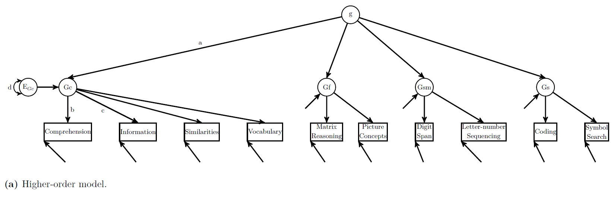
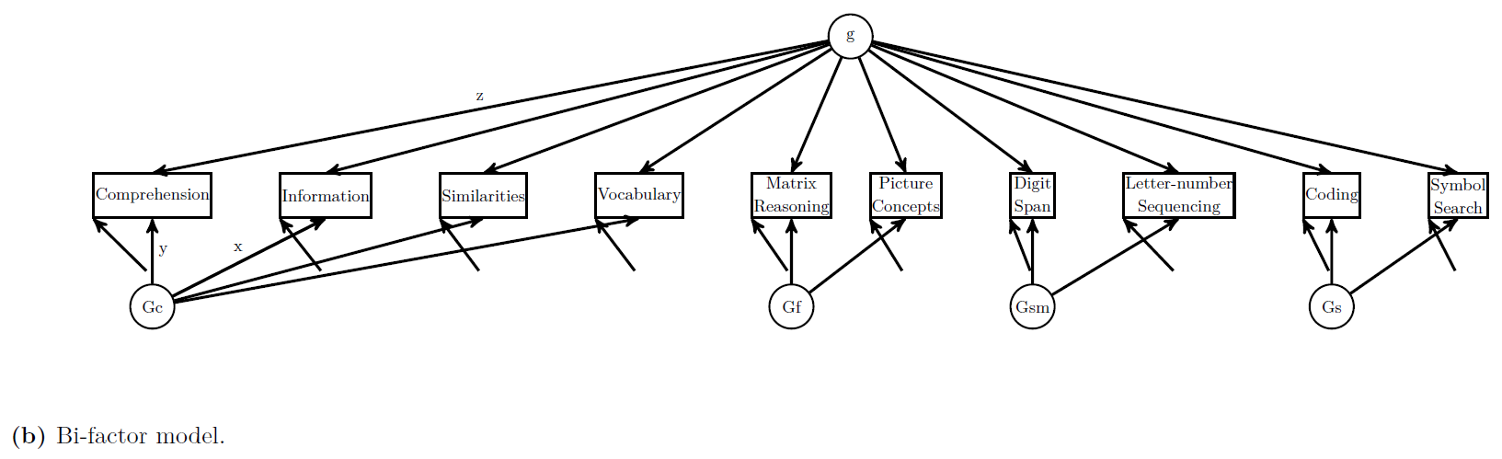
Beaujean book, Figure 9.1 (see chapter 9)

Slide 7
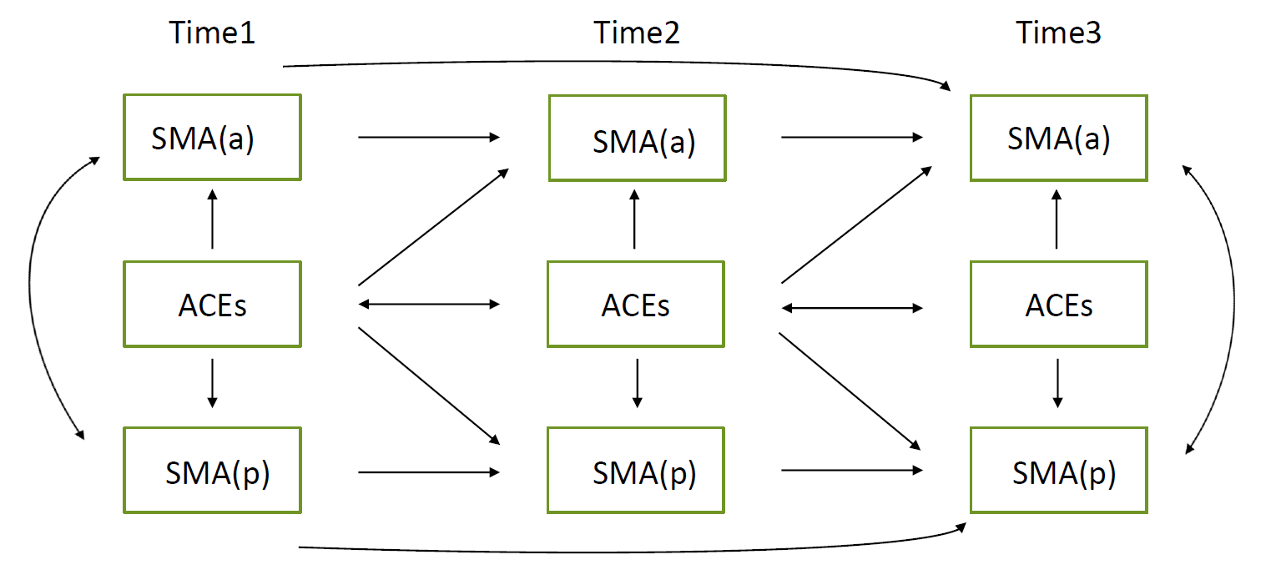

Slide 8
Remove items because loadings are too low?
No!
CFA fit measures should not be the main determinant of validity! You define the construct.
Check item content when loadings are low:
Can improve the item?
Might this item simply have low variance, explaining the low loadings?
If you want to remove an item: Make sure content validity is not harmed. It is in the questionnaire for a reason.

Slide 9
Missing data?
With (R)ML estimation, can use full-information maximum likelihood (FIML). Add to call:
missing = “fiml”
With DWLS(MV) estimation, can use pairwise-complete observations. Add to call:
missing = “pairwise”
Multiple imputation is the gold standard. Outside the scope of this basic course. In fact, FIML (and pairwise complete) often perform equally well
Schafer, J.L. and Graham, J.W. (2002). Missing Data: Our View of the State of the Art. Psychological Methods, 7(2), 147-177.

Slide 11
Missing data
Missing Completely At Random (MCAR)
As name implies, missingness is completely random (i..e, not associated with any variables in the model.
Nothing systematic that makes some values more likely to be missing than others.
Missing At Random (MAR)
There is a systematic relationship between the missingness and the observed data, but not the missing data.
Whether an observation is missing is independent from the missing value itself, but it may be dependent on other observed variables in the model
E.g., dataset with gender and weight. Gender has no missings, weight has missings
If women are more likely to have weight missing, missing is MAR
If people with higher weight are more likely to have missing weight, missing is MNAR
Missing Not At Random (MNAR)
Missingness and missing values are dependent
Note: what is MNAR in one model may be MAR in another model
E.g., if women are more likely not to report their weight than men, and gender is not included in the model, missing MNAR. If gender is included in the model, missing is MAR
Thus, can make MNAR into MAR by adding variables to the model (‘auxiliary variables’ approach)

Slide 12
Missing data
Unlikely in practice
Missing Completely At Random (MCAR)
As name implies, missingness is completely random (i..e, not associated with any variables in the model.
Nothing systematic that makes some values more likely to be missing than others.
Missing At Random (MAR)
There is a systematic relationship between the missingness and the observed data, but not the missing data.
Whether an observation is missing is independent from the missing value itself, but it may be dependent on other observed variables in the model
E.g., dataset with gender and weight. Gender has no missings, weight has missings
If women are more likely to have weight missing, missing is MAR
If people with higher weight are more likely to have missing weight, missing is MNAR
Missing Not At Random (MNAR)
Missingness and missing values are dependent
Note: what is MNAR in one model may be MAR in another model
E.g., if women are more likely not to report their weight than men, and gender is not included in the model, missing MNAR. If gender is included in the model, missing is MAR
Thus, can make MNAR into MAR by adding variables to the model (‘auxiliary variables’ approach)
Can be dealt
with in analysis
Problematic

Slide 13
Missing data
Listwise deletion
Best avoided
Only not problematic if data are MCAR and very little missingness
Although power is reduced, parameter estimates are unbiased
Analysis based on pairwise complete observations
Unbiased parameter estimates when missing data are MAR
Can add ’auxiliary variable(s)’ (i.e., variable(s) that contain information about missing values, but were not part of the original model) to turn MNAR into MAR
Use full information maximum likelihood (FIML) estimation
Yields unbiased parameter estimates when missing data are MAR
Can add ’auxiliary variable(s)’ (i.e., variable(s) that contain information about missing values, but were not part of the original model) to turn MNAR into MAR
Multiple imputation (MI)
Outside scope of this course
Both FIML and MI perform similarly well (i.e., parameter estimates are unbiased) when data are MCAR or MAR (Schafer & Graham, 2002)

